Slide 1
Chapter 6
Work and Power
Section 3 – Notes on Levers ONLY

Slide 2
Levers
A lever is a rigid bar that is free to turn about a fixed point.
The fixed point about which a lever rotates is called the fulcrum.
The input arm of a lever is the distance from the fulcrum to where the input is applied (usually by a person)
The output arm of a lever is the distance from the fulcrum to where the output is exerted by the lever.

Slide 3
Locating the Positions on a Lever
Fulcrum is the fixed point about which the lever rotates
Load/Output Force is what the lever is lifting/moving
Effort/Input Force is usually where you are applying the force.

Slide 4
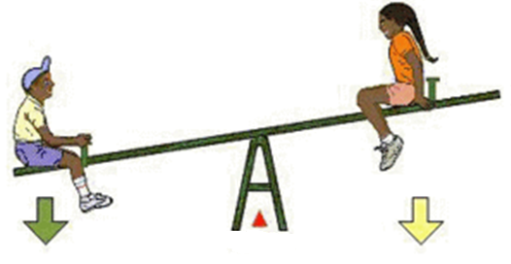
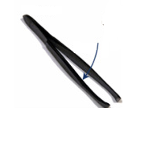
Label the Fulcrum, Load and Effort

Slide 5
The Three Classes of Levers
There are three classes of levers depending on where the FULCRUM, EFFORT and LOAD are located on the lever or which of these positions located in the CENTER…. Think, FLE
1st Class Lever | 2nd Class Lever | 3rd Class Lever
FULCRUM is located in the center | LOAD is located in the center | EFFORT is located in the center

Slide 6
Identify the Lever Class

